Slide 1
A Theoretical View of Saturn’s Ring
马磊
10210190005

Slide 2
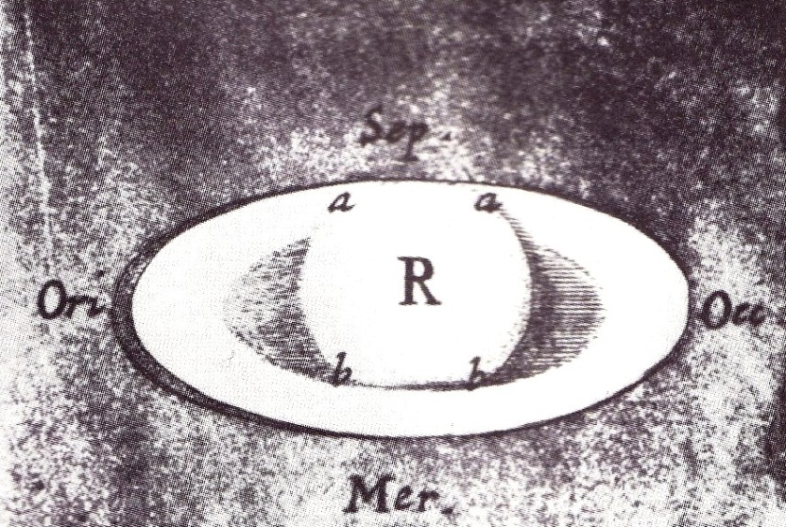
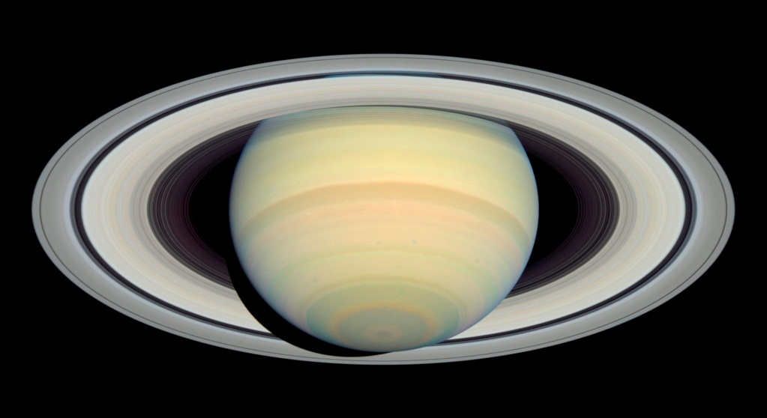
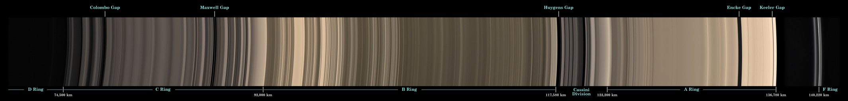
Characteristics
Robert Hooke
HST's ACS (March 22, 2004)
Natural-color mosaic of Cassini narrow-angle camera images (May 9, 2007)
Rings of Saturn. Wikipedia. 2010-11-27

Slide 3
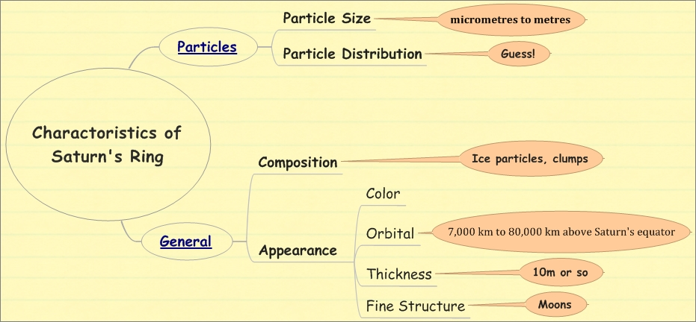
Characteristics
Knowledge we accumulated about Saturn’s Ring in the past centuries
Detailed references will be listed at the end of these slides.

Slide 4
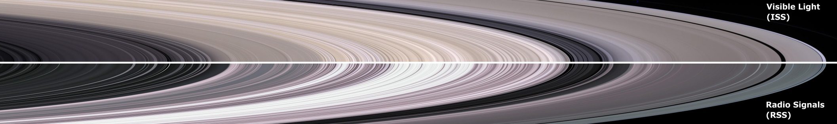
Characteristics
Spokes structure in B ring
Disturbance from Moons
Complete structure investigation?
Far from complete!
Rings of Saturn. Wikipedia. 2010-11-27

Slide 5
Theoretical View
Fine Structure
Particle Distribution
Particle Size
Most concerned here!

Slide 6
Theoretical View
Tidal force
Maximum particle size
Gravitation
Size distribution
CAM
Friction
Thin
Ringlets
Collision
Power law
Spokes etc.

Slide 7
Theoretical View
Maximum size
(Hint: Similar to Roche Limit)
Tidal Force
Tensile Force
=> r~10^7m to 10^8m => R<100km
M is the mass of Saturn; r is the orbital radius of the particles; ρ is the density of the particles (ice); R is the maximum size
Peter Goldreich, Scott Tremaine, (1982) "The dynamics of planetary rings". Ann. Rev. Astron. Astrophys. 20: 249-83.

Slide 8
Theoretical View
Size distribution
Assumption: Power law form
N(R) is the number of particles per unit area with radii less than R; R₀ is a scaled radius.
Considering the normalization condition, optical depth observation, surface density observation, occultation exp. et al., Goldreich reached a result of R_{min}=13cm, R_{max}=200m.
Richard G. French & Philip D. Nicholson (2000) did a great work on the particle size problem.
Peter Goldreich, Scott Tremaine, (1982) "The dynamics of planetary rings". Ann. Rev. Astron. Astrophys. 20: 249-83.

Slide 9
Theoretical View
Thickness
Thin ring
momentum conservation & gravitational force
Thickness
Viral theorem
, in which R is the particle size.
Peter Goldreich, Scott Tremaine, (1982) "The dynamics of planetary rings". Ann. Rev. Astron. Astrophys. 20: 249-83.

Slide 10
Theoretical View
Ringlets (instability)
Many ways to investigate the dynamics of rings. A simple model is to treat the rings as fluid. Fluid mechanics would be useful!
Particle drift flux at radius R:
In which
\Omega is the orbital angular frequency; \niu is the kinematic viscosity; \Sigma is the surface number density.
Adopt power law hypothesis
\sigma is the velocity dispersion.
D. N.C. Lin & P. Bodenheimer, (1981) “On The Stability of Saturn’s Rings”. The Astro. J. 248:L83-L86

Slide 11
Theoretical View
Ringlets (instability)
Rewrite the drift fulx
where
Instable states exists!
D. N.C. Lin & P. Bodenheimer, (1981) “On The Stability of Saturn’s Rings”. The Astro. J. 248:L83-L86
Notes:
Know that it instable states exists!

Slide 12
Theoretical View
Ringlets (instability)
That formula actually tells us nothing! We have to do some approximation.
\niu is substituted by
A is the cross section of a typical particle in EM scattering.
Stability is connected with the power-law exponent!
A more precise work is done in Lin’s paper!
D. N.C. Lin & P. Bodenheimer, (1981) “On The Stability of Saturn’s Rings”. The Astro. J. 248:L83-L86
Notes:
A is the cross section!!!

Slide 13
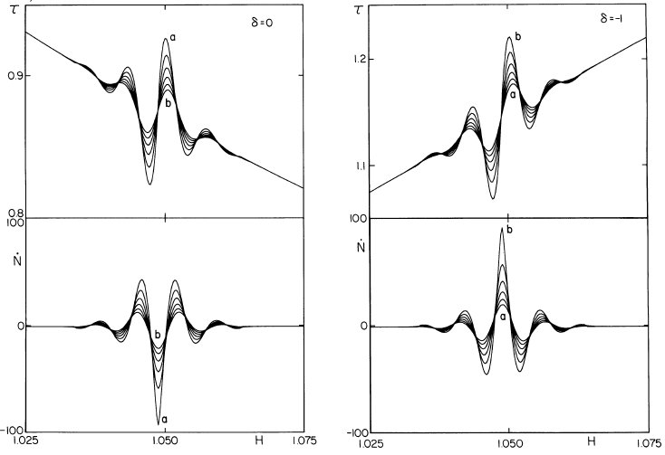
Theoretical View
Stable!
Instable!
Fig. 1
Fig. 2
D. N.C. Lin & P. Bodenheimer, (1981) “On The Stability of Saturn’s Rings”. The Astro. J. 248:L83-L86
Notes:
Numerical method!

Slide 14
Theoretical View
Less dissipation!
Or less production of entropy!
D. N.C. Lin & P. Bodenheimer, (1981) “On The Stability of Saturn’s Rings”. The Astro. J. 248:L83-L86

Slide 15
Theoretical View
Ringlets (instability)
Key points here:
Fluid mechanic method.
Viscous couple.
Power law assumption.
Things need to be investigated:
1. Time dependent stability
2. Non-axisymmetric perturbations
3. Origin of power law
4. Lifetime of the ring (another kind of stability)
D. N.C. Lin & P. Bodenheimer, (1981) “On The Stability of Saturn’s Rings”. The Astro. J. 248:L83-L86

Slide 16
Conclusion?
Tidal force
Maximum particle size
Gravitation
Size distribution
CAM
Friction
Thin
Ringlets
Collision
Power law
Spokes etc.
D. N.C. Lin & P. Bodenheimer, (1981) “On The Stability of Saturn’s Rings”. The Astro. J. 248:L83-L86

Slide 17
Theoretical View
D. N.C. Lin & P. Bodenheimer, (1981) “On The Stability of Saturn’s Rings”. The Astro. J. 248:L83-L86

Slide 18
Acknowledgement
Thanks to
Luo Yin and Fu Zhaoming for their helpful discussions on computer simulation,
Professor Zhou for his inspiring lectures.

Slide 19
More Ref. of The Characteristcs
A. Micro properties, i.e., details about those particles.
1. Particle size.
Particles vary from micrometres to metres.[http://www.nasa.gov/worldbook/saturn_worldbook.html].
2. Particle distribution.
The rings are roughly less denser and possess smaller particles when their orbital radii become smaller. But it is really a complex distribution if we look into its fine structure.
3. Particle ingredients.
Those particles are mainly composed of ice with little tholins or silicates. [Nicholson, P.D. and 16 co-authors (2008). "A close look at Saturn's rings with Cassini VIMS" (http:/ / adsabs. harvard. edu/ abs/ 2008Icar.
193. . 182N). Icarus 193: 182\[Dash]212. doi:10.1016/j.icarus.2007.08.036. .]
B. Marcro properties.
1. Color.
It is generally ashen seen from Cassini spacecraft's natural color photo obtained on May 9, 2007. [http://photojournal.jpl.nasa.gov/catalog/PIA08389]
2. Optical depth.
This is important because we can get infomation about the general distribution of matter by testing it. The outcome is that the ring is subdivided into ringlets which are of high optical depth and gaps which are of low optical depth.
3. Thickness.
It is 10m or so which means the ring is one particle thick disk. [Lane, A.L.. et al. Science 215, 537-543 (1982)][Zebker, H. A. & Tyler, G. L. Science (1984)][Cornell University News Service (2005-11-10). "Researchers Find Gravitational Wakes In Saturn's Rings" (http:/ / www. sciencedaily. com/
releases/ 2005/ 11/ 051110220809. htm). ScienceDaily. . Retrieved 2008-12-24.
]
4. Orbital.
Typical radius of rings are about 1.2*10^8 meters and typical angular speed in rings is 3*10^-4 s^-1.[Null (1976)] Most of the rings are almost perfect circles except a few rings. [Porco, C.; Nicholson, P. D.; Borderies, N.; Danielson, G. E.; Goldreich, P.; Holberg, J. B.; Lane, A. L. (October 1984). "The Eccentric
Saturnian Ringlets at 1.29RS and 1.45RS". Icarus (Elsevier Science) 60 (1): 1\[Dash]16. doi:10.1016/0019-1035(84)90134-9.][Porco, C. C.; Nicholson, P. D. (November 1987). "Eccentric features in Saturn's outer C ring". Icarus (Elsevier Science) 72 (2): 437\[Dash]467.
doi:10.1016/0019-1035(87)90185-0.]
5. disturbance.
This characteristic is important for disturbance indicates additional condensation objects otherwise we have to find out a intrinsic mechanism for this phenomenon such as a theory the same as the one for spiral arm of galaxies. [Hedman, Matthew M.; Burns, Joseph A,; Showalter, Mark R. at al. (2007). "Saturn's dynamic D ring" (http:/ / ciclops. org/ media/ sp/ 2007/
2678_7440_0. pdf) (pdf). Icarus 188: 89\[Dash]107. doi:10.1016/j.icarus.2006.11.017. .][Weiss, J. W.; Porco, C. C.; Tiscareno, M. S. (11 June 2009). "Ring Edge Waves and the Masses of Nearby Satellites" (http:/ / www. iop.
org/ EJ/ abstract/ 1538-3881/ 138/ 1/ 272/ ). The Astronomical Journal (American Astronomical Society) 138 (1): 272\[Dash]286.
doi:10.1088/0004-6256/138/1/272. . Retrieved 2009-06-15.][Porco, C.C.; Baker, E.; Barbara, J., et al. (2005). "Cassini Imaging Science: Initial Results on Saturn\[CloseCurlyQuote]sRings and Small Satellites" (http:/ /
ciclops. org/ sci/ docs/ RingsSatsPaper. pdf) (pdf). Science 307 (5713): 1226\[Dash]1236. doi:10.1126/science.1108056. PMID 15731439. .](This paper is very important.) It is unexplained that the B ring has a spokes structure.

